Slide 1
Simulation records
Ningjing Liu
20230327

Slide 2
Simulation.py
Simulation_III.py
Simulation_VII.py
0-1:
workers = 1
batch_size = 128
nz = 100
ngf = 64
ndf = 64
num_epochs = 10000
lr = 0.001
beta1 = 0.5
III-1:
workers = 2
batch_size = 100
nz = 100
ngf = 64
ndf = 64
num_epochs = 1000
lr = 0.001
beta1 = 0.1
VII-1:
workers = 1
batch_size = 128
nz = 100
ngf = 64
ndf = 64
num_epochs = 1000
lr = 0.001
beta1 = 0.5
III-2:
workers = 3
batch_size = 128
nz = 100
ngf = 64
ndf = 64
num_epochs = 10000
lr = 0.005
beta1 = 0.5
The best one
VII-2:
workers = 1
batch_size = 128
nz = 100
ngf = 64
ndf = 64
num_epochs = 10000
lr = 0.001
beta1 = 0.5

Slide 3
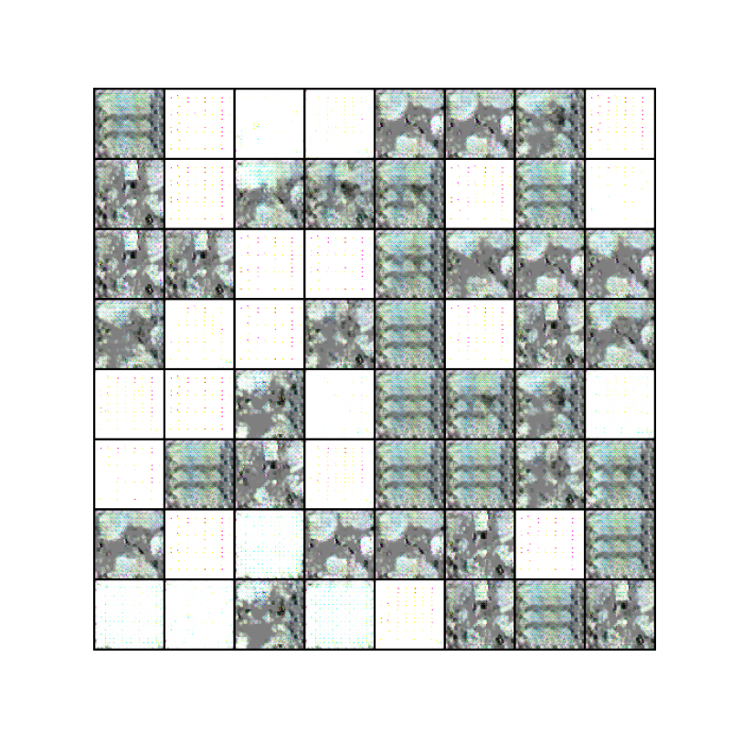
Simulation.py
Running time: ~72 h
0-1:
workers = 1
batch_size = 128
nz = 100
ngf = 64
ndf = 64
num_epochs = 10000
lr = 0.001
beta1 = 0.5

Slide 4
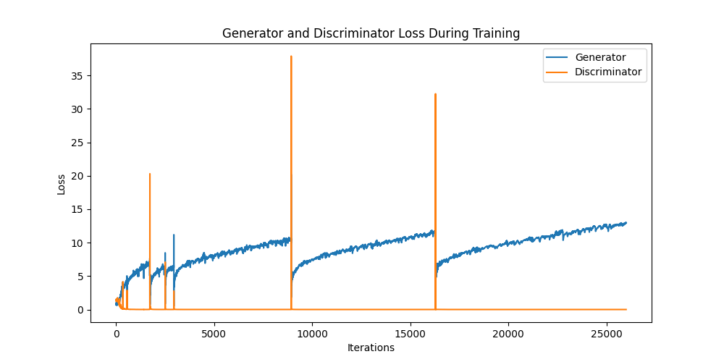
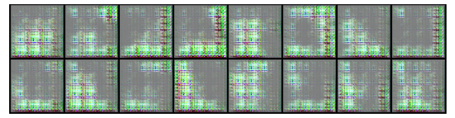
Simulation_III_1.py
Running time: ~6 h
III-1:
workers = 2
batch_size = 100
nz = 100
ngf = 64
ndf = 64
num_epochs = 1000
lr = 0.001
beta1 = 0.1

Slide 5
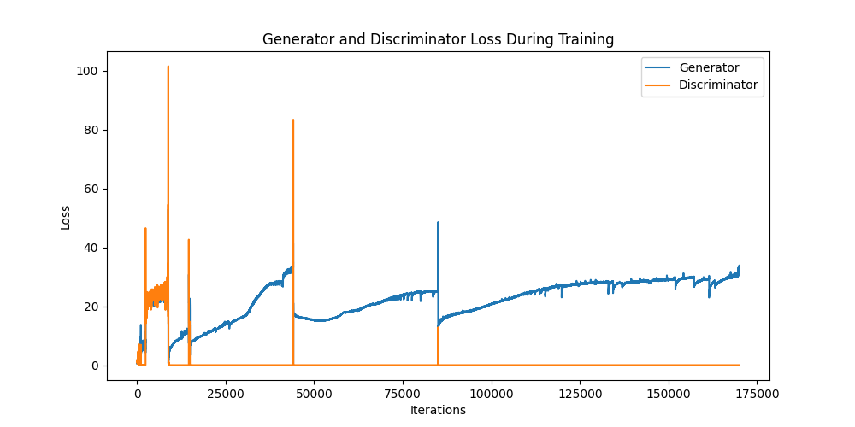
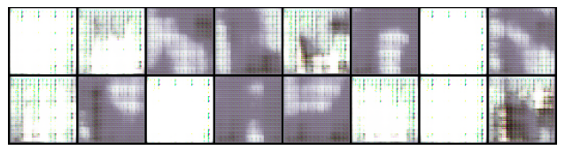
Simulation_III_2.py
Running time: ~33 h
III-2:
workers = 3
batch_size = 128
nz = 100
ngf = 64
ndf = 64
num_epochs = 10000
lr = 0.005
beta1 = 0.5

Slide 6
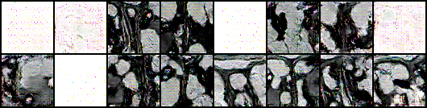
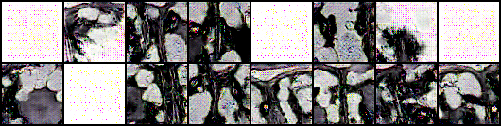
Simulation_VII_1.py
Running time: ~24 h
VII-1:
workers = 1
batch_size = 128
nz = 100
ngf = 64
ndf = 64
num_epochs = 1000
lr = 0.001
beta1 = 0.5
970
999

Slide 7
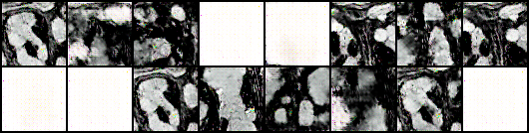

Simulation_VII_2.py
Running time: ~72 h
VII-2:
workers = 1
batch_size = 128
nz = 100
ngf = 64
ndf = 64
num_epochs = 10000
lr = 0.001
beta1 = 0.5
7500
9999

